Slide 1
Title: An evaluation of Early Grade Reading Assessment in Namibia
SAAEA Conference: 19 – 22 May 2019
Gaborone, Botswana
Eino Haifidi (eheavydy@gmail.com)
Directorate of National Examinations and Assessment: MoEAC, Windhoek, Namibia
EGRA

Slide 2
Outline
What is EGRA ?
Purpose of EGRA
EGRA application in Africa
Background of EGRA in Namibia
What prompted EGRA in Namibia?
SACMEQ Countries
The Namibian EGRA tool
Funding of EGRA
EGRA Pilot
EGRA Intervention Strategy
Achievements
Challenges in the implementation process
Recommendations
Conclusion

Slide 3
1. What is EGRA?
Early Grade Reading Assessment (EGRA) is a one-on-one reading assessment.
The EGRA concept was developed in the United States in 2006.
EGRA is now being used in over 70 countries and in more than 120 languages worldwide.

Slide 4
2. Purpose of EGRA
To diagnose strengths and weaknesses in early reading.
To provide immediate feedback to the educators.
To update educators and parents on the status of reading of their children.
To provide information for teachers upon which to base their planning.

Slide 5
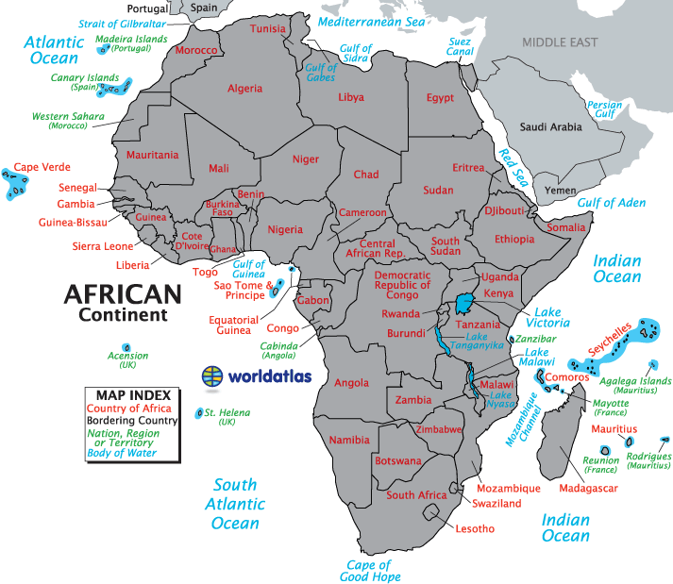
3. EGRA Application in Africa
01. Egypt
02. Ethiopia
03. Kenya
04. Uganda
05. Malawi
06. Zambia
07. South Africa
08. DRC
09. Ghana
10. Rwanda
11. Liberia
12. Mali
13. Mozambique
14. Madagascar
15. Nigeria
16. Sierra Leone
17. Senegal
18. Gambia
19. Tanzania
20. Namibia

Slide 6
4. Background of EGRA in Namibia
EGRA was introduced in Namibia in 2012.
Piloted in three languages.
In three different regions (Hardap, Kavango and Oshikoto).
Now available in six languages. (Khoekhoegowab, Oshindonga, ESL, Rukwangali, Oshikwanyama & Otjiherero).

Slide 7
5. What prompted EGRA in Namibia?
Vision 2030 - calls for equitable social development.
MoEAC strategy on the development of early literacy to lay a strong foundation reading to avoid gaps in learning.
The poor literacy outcomes for Namibia in the Southern and Eastern Africa Consortium for Monitoring Educational Quality project three (SACMEQ III – 2010) report.

Slide 8
6. SACMEQ Countries

Slide 9
7. The Namibian EGRA tool
Consists of five subtasks:
Phonemic awareness (for sound discrimination - auditory)
Phonics (linking sounds to letters/symbols to form a letter sound – visual & auditory)
Non-word reading (develop fluency)
Passage reading (develop vocabulary)
Comprehension questions (understanding)
All the subtasks are timed (1 minute), except the phonemic awareness and the comprehension subtask.

Slide 10
8. Funding of EGRA
The EGRA project was co-funded by the two organisations:
Education Development Trust (formerly known as the Centre for British Teachers [CfBT] Education Trust).
The Education Training Sector Improvement Programme (ETSIP) within the MoEAC.

Slide 11
9. The EGRA Pilot
The EGRA pilot was conducted from January 2012 to May 2012.
The main objective of the pilot was to develop the EGRA Namibian tool.
The EGRA tools were developed by the National Institute of Educational Development (NIED).

Slide 12
The pilot report concluded with a list of recommendations guiding the EGRA programme into the future.
The development of the EGRA tools in all languages
The administrators’ training
The field testing
The intervention strategy

Slide 13
The pilot outcomes further indicated that;
learners who attended pre-primary school produce better results than their peers.
Girls perform better in early literacy than boys.
Generally, all regions indicated the need for improved literacy teaching focusing on comprehension.

Slide 14
10. EGRA Intervention Strategy
The objectives of the intervention were to ensure that;
The literacy teaching manuals were developed in all curriculum languages.
Learners enter the system with the pre-requisite literacy learning readiness in the JP phase.

Slide 15
11. Achievements
The EGRA pilot and field testing were successfully done.
The Namibian EGRA tool developed in six languages.
EGRA tools developed in the 5 local languages where Namibia is among the first few countries to do so.
Findings from the pilot shared with the regions.
Literacy teaching manuals were developed in all curriculum languages for the intervention strategy.

Slide 16
The EGRA pilot findings guided the 2013/14 JP curriculum review which was implemented in 2015.
The EGRA implementation conceptual framework is developed.

Slide 17
12. Challenges in the implementation process
EGRA tools are yet to be developed in the remaining seven curriculum languages.
EGRA tools developed in six languages are yet to be fully disseminated to the relevant regions/schools.
EGRA tool is not equivalent to a particular grade.
The literacy teaching manuals are yet to be disseminated to regions/schools.

Slide 18
13. Recommendations
EGRA tools to be developed in 7 languages remaining.
EGRA tools to be disseminated to all the regions countrywide.
The EGRA tool should be reviewed in order to be equivalent to a particular grade.
The literacy teaching manuals should be disseminated to regions/schools.
EGRA assessment should be used at the JP phase to monitor literacy teaching at the foundation level in Namibia.

Slide 19
14. Conclusion
Assessments are important for measuring learning and for knowing whether the education system is producing the desired results for learners.
Without effective assessment it is impossible to know whether learners are learning, as well as knowing if the curriculum reviews are working.
“Assessment goes to the heart of what matters in education: not just enrollment and completion rates, but the ultimate goal of student learning”
(Marguerite Clarke, p. 1, 2012).

Slide 20
Thank you
Questions and Comments…..
EGRA

